Slide 1
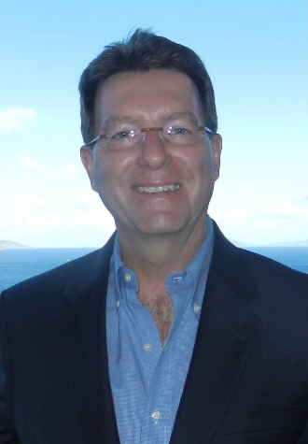
CLIC 804:
Innovation by
Design
Session 07B:
Interviewing for Insight (IFI)
Dr. Tim Faley
Kiril Sokoloff Distinguished Professor of Entrepreneurship
Special Assistant to the President for Entrepreneurial Initiatives
University of the Virgin Islands
St. Thomas Campus; Tfaley@UVI.edu

Slide 2
Interviewing for Insight: How to get information people have in their heads that they don’t even know is there? (tacit knowledge)

Slide 3
Getting from Speculation to Fact Which column?
Thing we want to know
Things we think we know.
Belief or data supported?
Thing we know
Data supported
…
…
Goal is to move things this way
Difference between something that is “Designed” and an “idea” is proof!

Slide 4
Who are you interviewing?
Think of a 360-degree review around your Principal Adopter
Most interviews will be with Potential Adopters
This is “Adopter Discovery”
Dividing YOUR innovation’ adopters from its non-adopters
Everyone = No One
Creators of alternative solutions
Existing and in the future
Learn about their thought process
What adopter need/want/desire are they targeting?
How are they making that connection? Value proposition?
Others
Suppliers, and other “collaborators” or “blockers”

Slide 5
VOCA – Virtual Observation Constant Annoyance
Most people exist in a state of acceptance
Apologists or Survivors
Asking direct questions almost always misleads
Focus groups are just another means of asking questions
Remember you are looking for “insights” not “answers”
Uncovering adopter “Wants/Needs/Desires” is VERY difficult
Most of us speak in terms of “answers”
“I’d like this…” “I wish I could get that….”
These proposed solutions satisfy WHAT need/want/desire? Ask WHY they would want that!
Desire is a stronger determinant of value than need
Need gets the adopter, desire makes them loyal
Experts and Zealots are difficult
Experience and non-data supported beliefs can bias results
They already “know” the answer – are not willing to consider alternatives
They will therefore NOT be your first adopters!
Articulating is difficult -- Hard to put the subconscious into words

Slide 6
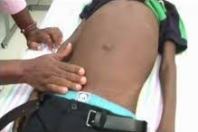
Finding something tender..
Use virtual observation to tell their story
Get them talking about the general topic you are interested in
Listen (active listening, not just words, see next slide)
Once find something of interest (tender – usually emotive response – lean forward, pace of talk quickens, etc.)… start asking “why” questions (slide 8)

Slide 7
Communication: Face-to-Face is BEST
“The one who listens does the most work, not the one who speaks.” Stephen R. Covey

Slide 8
Drilling Down with the “Why” Chain
Drilling down to find the root of an opportunity
The evolution of an idea leads from (a) today’s solutions, to (b) ‘why’ these solutions exist & understanding their limitations
Why? – To the roots of the true issues
(b)
The ‘Why’ Chain
Why?
Why?
Today’s solutions
(a)

Slide 9
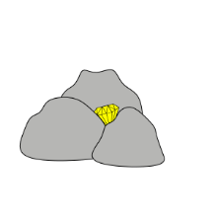
Is this problem a “big deal” for them?
High-value problem
How do they manage now?
Must always know the problem-owner’s BATNO
Best Alternative To a New (solution) Option
What is the specific issue that the current solution addresses? What does it NOT address?
What are the advantages/disadvantages of the current solution?
Diamond in the Rough

Slide 10
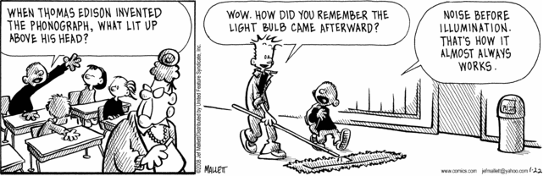
Noise before illumination….
FRAZZ

Slide 11
Evaluate the interview data
Are there “themes” in the problems you are hearing?
Can you create “groups” that have different “themes” of issues
Persona Development is an ORGANIZE activity (step 2 of the DOC Process)
Remember some will be your adopters, some will NOT be your adopters.
In adopter segmentation: EVERYone = No-one
No business tries to serve EVERYONE
Focus on your TARGET adopters
Yes, you’ll get adopters outside that target, but you must AIM at SOMEthing. (If you shoot at “everything” you’ll hit “nothing”).
What insights did you gain?
What did you move from “want to know” or “think you know” to data-supported “know” column (see next slide)?

Slide 12
Getting from Speculation to Fact Which column?
Thing we want to know
Things we think we know.
Belief or data supported?
Thing we know
Data supported
…
…
Goal is to move things this way
Difference between a “Designed” business and a business “idea” is proof!

Slide 13
Questions?
Zoom session on this Session.
See syllabus for time/date.

